Slide 1


Department of Computer Science and Engineering
Audio Summarization in real time for podcast, speeches and audio books
LOGESH KUMAR D [211419104148]
NARENDHIRAN S [211419104176]
HEMANTH S [211419104101]
Mr.A.N.SASIKUMAR, M.E & ASSISTANT PROFESSOR
Dr.G.SENTHIL KUMAR, M.C.A.,M.Phil.,M.B.A., M.E., Ph.D., & PROFESSOR

Slide 2
Introduction
The field of spatial audio is gaining significance due to the rising demand for immersive communication technologies, such as virtual and augmented reality, gaming, and teleconferencing. Spatial audio research involves various domains, including audio engineering, acoustics, computer science, and psychoacoustics.
Its aim is to recreate or synthesize acoustic environments using a combination of sound recording, processing, and reproduction techniques.
Spatial audio techniques can be broadly categorized into capture, processing, and reproduction stages. Summarization and optical character recognition (OCR) are also essential techniques for condensing data and identifying text from imagery or digitized documents.
The pdf2image module is used to convert PDF files into an image array, which is then transmitted to OCR for digitization and text identification.

Slide 3
Objective of the Project
To develop a spatial audio pipeline for creating immersive audio experiences in virtual and augmented reality applications.
To investigate the psychoacoustic properties of spatial audio and their impact on listener perception and engagement.
To design and implement novel spatial audio capture techniques for use in live performance and installation settings.
To optimize spatial audio processing algorithms for real-time applications with low-latency requirements, such as gaming and teleconferencing.
To explore the potential of spatial audio for enhancing accessibility and inclusivity in audio content, particularly for individuals with hearing impairments.
To evaluate the impact of spatial audio on user experience in various contexts, such as entertainment, education, and healthcare

Slide 4
Literature Survey
Title | Author | Pros | Cons
A Survey of Automatic Summarization of Texts | Shalini Singh, Ashish Verma | Comprehensive overview of automatic summarization techniques for text. | Focused solely on text summarization.
A Review on Audio Signal Summarization Techniques | Neha Kumari, S. S. Sonavane | Provides an overview of audio signal summarization techniques. | Limited coverage of recent developments in audio summarization research.
Text Summarization Techniques: A Brief Survey | Vandana Tayal, Prerna Agarwal | Comprehensive overview of text summarization techniques, including unsupervised, supervised, and hybrid approaches. | Focused solely on text summarization.

Slide 5
Literature Survey
Audio Summarization Techniques: A Survey | Prateeksha Gupta, Ankur Agarwal | Provides a comprehensive overview of audio summarization techniques, including speech recognition, speaker identification, and audio segmentation. | Limited coverage of recent developments in audio summarization research.
Graph-Based Text Summarization: A Survey | Ankur Singh, Jayant Shekhar, Partha Pratim Roy | Provides a detailed overview of graph-based text summarization techniques. | Focused solely on graph-based text summarization.
Video Summarization: A Survey | Juwei Lu, Huanzhou Xu, Pengfei Xu | Provides an overview of video summarization techniques, including keyframe extraction, video skimming, and storyboard generation. | Limited coverage of recent developments in video summarization research.

Slide 6
Literature Survey
A Survey on Audio Summarization Techniques for Music and Speech | Devansh Gupta, N. K. Sharma, K. Singh | Provides an overview of audio summarization techniques for music and speech, including speech-to-text conversion and speaker diarization. | Limited coverage of recent developments in audio summarization research.
An Overview of Neural Network-based Text Summarization Methods | Ying Qiao, Wangsheng Zhu, Min Yang | Provides a comprehensive overview of neural network-based text summarization methods, including sequence-to-sequence models and attention-based models. | Focused solely on neural network-based text summarization.

Slide 7
Problem Statement
• The existing system only identifies emotions when any audio input is given
• The existing system uses python speech recognition library which might not work for all the inputs since the library has dependency issues
• The existing system cant analyze if a big dataset of audio files are passed as an input because the existing system isnt trained with large dataset

Slide 8
Proposed System
To retrieve and transcribe podcast episodes, we must first register for an account and free plan on the Listen Notes API website.
After selecting the desired podcast episode, we use the AssemblyAI to transcribe the audio by sending a POST request with the audio URL and setting auto chapter to True.
The id of the transcription answer is saved for future reference. We then send a GET request to AssemblyAI until the response status is completed and save the resulting transcription and summary in separate txt and JSON files, respectively. Audio transcription is the process of converting any audio recording, such as an interview or music video, into a text file.
The process of translating an audio file into a text file is referred to as audio transcription. This could be an audio recording of anything; for example, an interview, an academic study, a music video clip, or a recording of a conference.

Slide 9
Software / Hardware used
Hardware specifications:
Microsoft Server enabled computers, preferably workstations
Higher RAM, of about 4GB or above
Processor of frequency 1.5GHz or above
Software specifications:
Python 3.6 and higher
Anaconda software

Slide 10
Architecture / Methodology used
The proposed methodology involves the creation of an audio summarization algorithm for podcasts using a multi-modal approach.
The algorithm will be developed by transcribing and summarizing an episode from listennote.com, a podcast that discusses various data science topics and provides guidance on becoming a data scientist.
The project will be implemented as a web application using Streamlit, and the AssemblyAI API will be used to transcribe and summarize the podcast episode.
The API will utilize automatic speech recognition to convert the audio into text and provide a summary of the text. The algorithm will incorporate both audio and text modalities to create a comprehensive and accurate summary of the podcast episode.

Slide 11
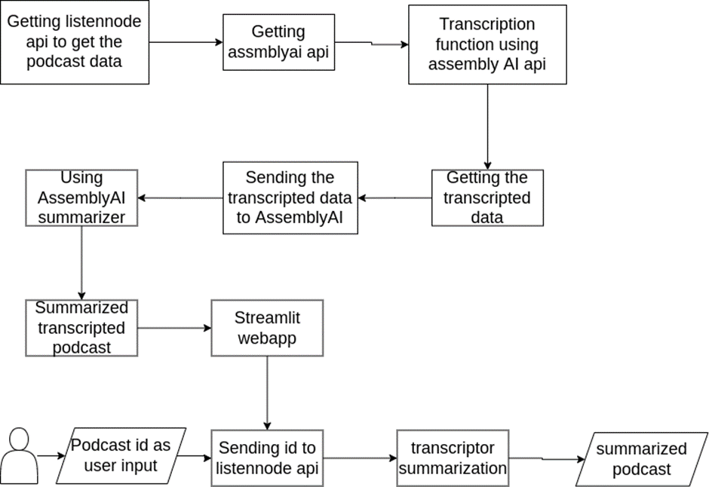
System Design - Flow Chart/DFD/ER

Slide 12
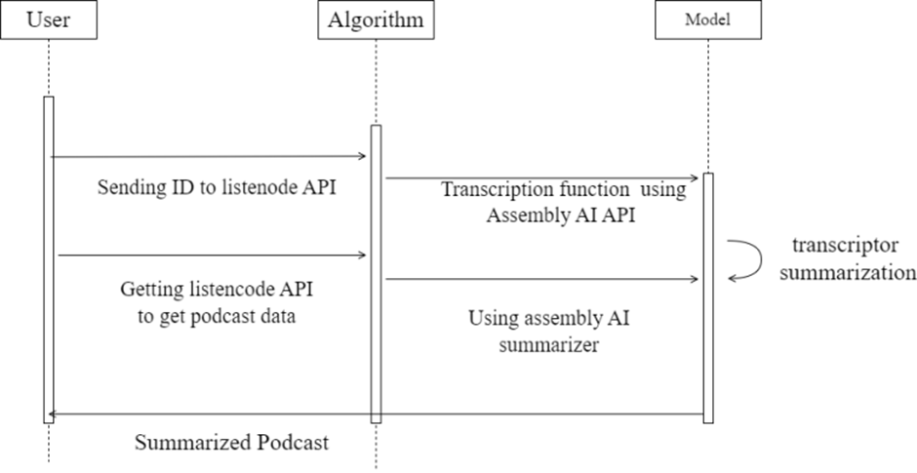
System Design - Flow Chart/DFD/ER

Slide 13
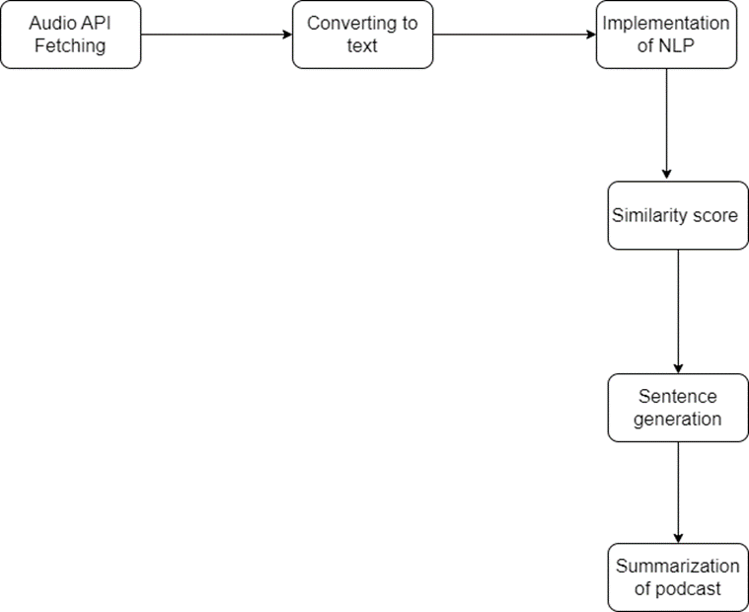
Module Description
Slide 14 to 17

Slide 14
Module Description
Module 1:Getting the PODCAST from the listennote api
The retrieval of information from the Listen Notes API is being accomplished through the use of a tactical operation known as submitting a GET request to the endpoint of the Listen Notes Podcast API. After everything is said and done, we store the final result as a JSON object. This object contains the episode's URL, which will be required at a later time.
In addition to that, we are importing a JSON file with the name secrets.json. This file is quite similar to a dictionary in that it contains a collection of key-value pairs much like a dictionary does. It is necessary for it to hold the API keys for AssemblyAI and Listen Notes, respectively. You will need to log into your accounts to access them.
Listennode API
Listen Node API is where we can search and get data related to API using podcast id.

Slide 15
Module Description
Module 2 : Transcription and summarization of the podcast
A POST request is sent to the AssemblyAI API for audio transcription. The auto chapter value is set to True to retrieve both transcription and summary. The results are saved into two different files, a txt file for transcription and a JSON file for summary.
The AssemblyAI API provides accurate text transcriptions and audio intelligence features such as Sentiment Analysis, Summarization, Entity Detection, and Topic Detection. Asynchronous transcription and real-time streaming transcription are available.
In case of errors, resubmitting the file for transcription is recommended. Audio summary condenses important ideas and themes from longer audiobooks into an easier-to-understand style.

Slide 16
Module Description
Module 3: Web App
The proposed web application using Streamlit aims to provide users with an easy-to-use interface for generating audio summaries of podcasts.
The app will ask the user to input the ID of the podcast they wish to summarize and then use the AssemblyAI API to transcribe and summarize the podcast.
The results will be displayed on the website, and a download button will be provided for users to save the transcription and summary as a compressed file.
The app will also provide local and network URLs for the user to access the results. The web app provides a simple and efficient solution for podcast listeners who want to quickly obtain a summary of their favorite episodes.

Slide 17
Testing /Performance Evaluation / Results
The result and performance evaluation of the proposed audio summarization algorithm will be based on the accuracy and quality of the generated summaries.
The summaries will be evaluated by comparing them with manually created summaries of the same podcast episode. Metrics such as precision, recall, and F1 score will be used to evaluate the algorithm's performance.
Additionally, user feedback and satisfaction surveys will be conducted to assess the overall effectiveness of the algorithm in meeting the needs and expectations of its users.
The results and evaluation of the algorithm will help identify areas for improvement and guide future development and refinement of the algorithm to better meet the needs of podcast listeners.

Slide 18
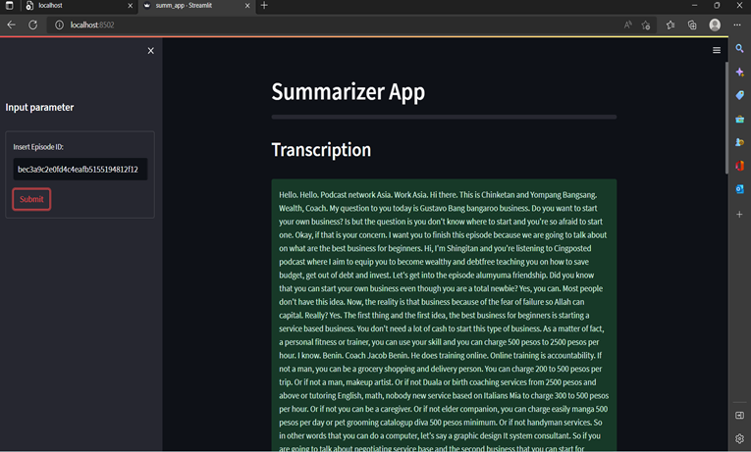
Screen Shots

Slide 19
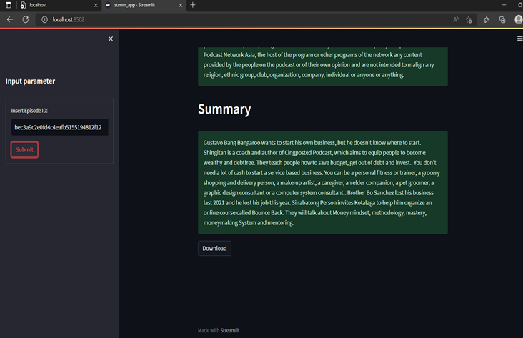
Screen Shots

Slide 20
Conclusion / Feature Enhancement
This project establishes the proof of working principle and sets direction for future development into a fully learned and automated method for podcast speech summarization.
Given the complex nature of such a problem, we believe there is plenty of room for improvements. Podcasts usually require active attention from a listener for extended periods unlike listening to music. In the process of generating a summary as discussed in this paper, the primary input taken for processing is an audio file.
The audio file is generated by recording the human speech which is being spoken or is already recorded. Subjective attributes such as the speaker’s presentation style, type of humor, or the production quality could influence the listener’s preference but are hard to discern from a text description. The produced summaries have intelligible audio information.

Slide 21
Reference Paper/ URL
[1] A. Vartakavi, A. Garg and Z. Rafii, "Audio Summarization for Podcasts," 2021 29th European Signal Processing Conference (EUSIPCO), 2021
[2] H. Lee and G. Lee, "Hierarchical Model For Long-Length Video Summarization With Adversarially Enhanced Audio/Visual Features," 2020 IEEE International Conference on Image Processing (ICIP), 2020
[3] M. -H. Su, C. -H. Wu and H. -T. Cheng, "A Two-Stage Transformer-Based Approach for Variable-Length Abstractive Summarization," in IEEE/ACM Transactions on Audio, Speech, and Language Processing,2020.
[4]Y. He, X. Xu, X. Liu, W. Ou and H. Lu, "Multimodal Transformer Networks with Latent Interaction for Audio-Visual Event Localization," 2021 IEEE International Conference on Multimedia and Expo (ICME), 2021
[5] A. Gidiotis and G. Tsoumakas, "A Divide-and-Conquer Approach to the Summarization of Long Documents," in IEEE/ACM Transactions on Audio, Speech, and Language Processing,2020
[6] R. K. Yadav, R. Bharti, R. Nagar and S. Kumar, "A Model For Recapitulating Audio Messages Using Machine Learning," 2020 International Conference for Emerging Technology (INCET), 2020

